Slide 1

CS4157
Software Quality
Notes:
CS5707 Software Development Paradigms
John Dawson
CS5707 Software Development Paradigms
John Dawson
CS5707 Software Development Paradigms
John Dawson

Slide 2
Last Week
The immature (Initial) process
A framework for Change Management
Your ideas on Quality
The Mythical Man-Month
Notes:
CS5707 Software Development Paradigms
John Dawson
CS5707 Software Development Paradigms
John Dawson
CS5707 Software Development Paradigms
John Dawson

Slide 3
Lecture Outline: Week 3 – 6th Feb
Software Process Models
CMM: Capability Maturity Model
ISO/IEC 12207 / 15504 / SPICE
Notes:
CS5707 Software Development Paradigms
John Dawson
CS5707 Software Development Paradigms
John Dawson
CS5707 Software Development Paradigms
John Dawson

Slide 4
Process Model History
Software Process Models & Software Process Improvement date from 1980s and 1990s, arising from experience of problems in the software industry
There are many models and standards, mostly related to each other, each with their own slant on the same basic issues
Many still under development, especially for industry specific requirements

Slide 5
Process Models Attributes
Staged or continuous
Measurement only or Process Improvement
General or targeted e.g. at a specific industry
Notes:
CS5707 Software Development Paradigms
John Dawson
CS5707 Software Development Paradigms
John Dawson
CS5707 Software Development Paradigms
John Dawson

Slide 6
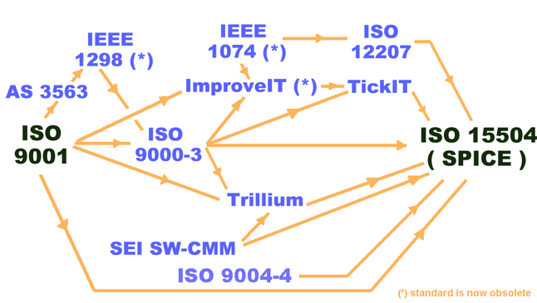
Some Process Model Relationships
Notes:
CS5707 Software Development Paradigms
John Dawson
CS5707 Software Development Paradigms
John Dawson
CS5707 Software Development Paradigms
John Dawson

Slide 7
Other Process Models
ISO 9001: one of the earliest and most general quality standards
ISO 9000-3: Application of ISO 9001 to the software industry
The IDEAL model: Initiating, Diagnosing, Establishing, Acting and Learning – paper
Framework for Change Management, Willman (1996) – last week
Notes:
CS5707 Software Development Paradigms
John Dawson
CS5707 Software Development Paradigms
John Dawson
CS5707 Software Development Paradigms
John Dawson

Slide 8
Lecture Outline: Week 3 – 6th Feb
Software Process Models
CMM: Capability Maturity Model
ISO/IEC 12207 / 15504 / SPICE
Notes:
CS5707 Software Development Paradigms
John Dawson
CS5707 Software Development Paradigms
John Dawson
CS5707 Software Development Paradigms
John Dawson

Slide 9
Capability Maturity Model: Overview
One of the earlier process models
Like other significant models, it is under continuous development
History: CMM refined into multiple models, including SW-CMM (for software), now superseded by CMMI (integration)
CMM characteristics
      Staged, rather than continuous
      Assessment, not process improvement
      Top level is a 5-level capability measure
Notes:
CS5707 Software Development Paradigms
John Dawson
CS5707 Software Development Paradigms
John Dawson
CS5707 Software Development Paradigms
John Dawson

Slide 10
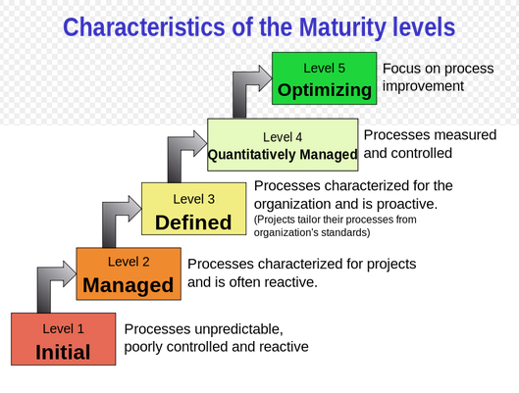
Capability Maturity Model: Pictorial
Notes:
CS5707 Software Development Paradigms
John Dawson
CS5707 Software Development Paradigms
John Dawson
CS5707 Software Development Paradigms
John Dawson

Slide 11
CMM Level 1: Initial / Ad-Hoc
Lack of good management practice; ineffective planning; re-active, not pro-active
Plans are abandoned under pressure
Success conditional upon capable, self-disciplined staff
Necessary practices are missing or poorly implemented: PM, CM, SQA
Notes:
CS5707 Software Development Paradigms
John Dawson
CS5707 Software Development Paradigms
John Dawson
CS5707 Software Development Paradigms
John Dawson

Slide 12
CMM Level 2: Repeatable / Intuitive
Policies, procedures and basic software management controls in place
Project planning commitments are realistic: based on both previous projects and current requirements
Schedule & cost are tracked; problems identified and addressed as they occur
Satisfactory procedures exist for handling subcontractors
Notes:
CS5707 Software Development Paradigms
John Dawson
CS5707 Software Development Paradigms
John Dawson
CS5707 Software Development Paradigms
John Dawson

Slide 13
CMM Level 3: Defined / Qualitative
Procedures are standardised and documented
Procedures are changed, as needed
An SEPG (Software Engineering Process Group) is responsible – for SQA
Organised training is in place
Standardarised procedures are tailored for specific projects
Progress and quality are tracked
Notes:
CS5707 Software Development Paradigms
John Dawson
CS5707 Software Development Paradigms
John Dawson
CS5707 Software Development Paradigms
John Dawson

Slide 14
CMM Level 4: Managed / Quantitative
Process and Product measured quantitatively i.e. Metrics
Defined project statistics are recorded and used for evaluation
(Hence) project process performance variability is narrowed
Software products are of predictably high quality
Notes:
CS5707 Software Development Paradigms
John Dawson
CS5707 Software Development Paradigms
John Dawson
CS5707 Software Development Paradigms
John Dawson

Slide 15
CMM Level 5: Optimising / Improving
Continuous process improvement
Proactive identification of weakness
Defects analysed to detect and address process problems
Beneficial innovations are propagated throughout the organisation
Notes:
CS5707 Software Development Paradigms
John Dawson
CS5707 Software Development Paradigms
John Dawson
CS5707 Software Development Paradigms
John Dawson

Slide 16
CMM: An Informal View
Level 1: You’re doing it
Level 2: You know you can do it
Level 3: You know how you do it
Level 4: You can say exactly how you do it
Level 5: You’re getting better at it all the time

Slide 17
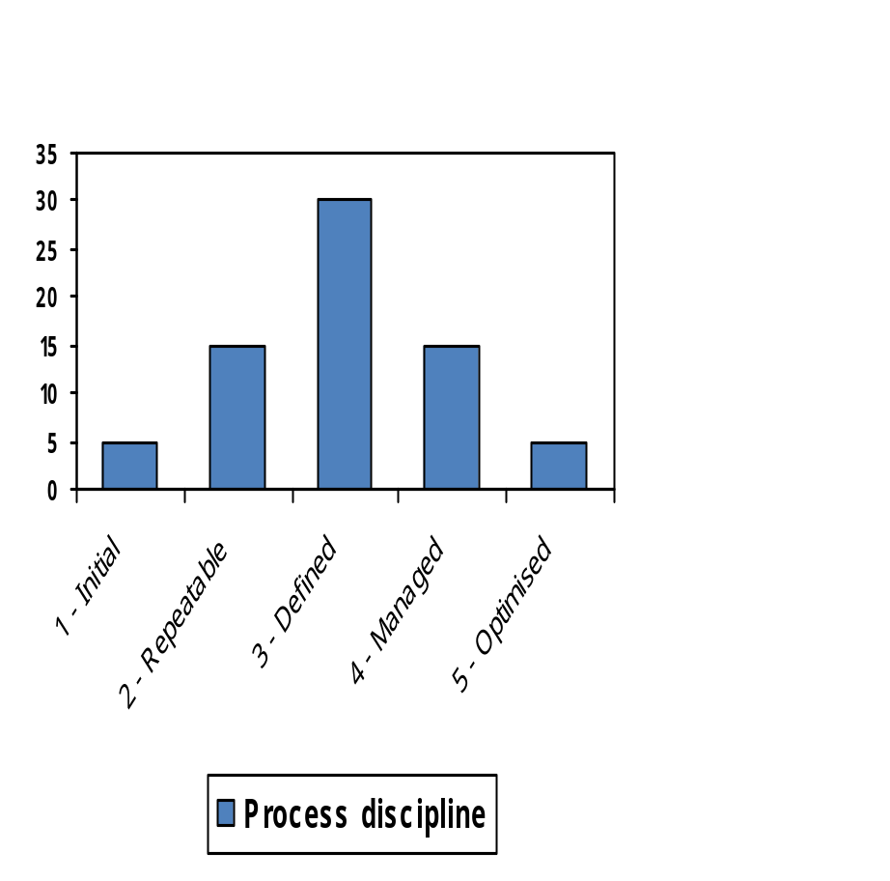
CMM: Another View – People
From 1 – 3 process discipline collectivises:
    individual → team → company
From 3 – 5 process discipline individualises:
    company → team → individual
… which brings us back to “capable people”, who are sufficiently self disciplined that they don’t need much process discipline?

Slide 18
CMM: Key Process Areas (KPAs): 1
The 5 maturity levels represent only the highest level of the CMM structure
The main sub-structure is KPAs; different KPAs are defined at each maturity level
Level 1 specifies no KPAs
Level 2 KPAs are found in most SPI initiatives e.g. PM, CM, SQA etc.
Level 3, 4 & 5 process include increasingly closely managed process descriptions
Notes:
CS5707 Software Development Paradigms
John Dawson
CS5707 Software Development Paradigms
John Dawson
CS5707 Software Development Paradigms
John Dawson

Slide 19
CMM: Key Process Areas (KPAs): 2
Level 2 sample processes:
      Requirements Management
      Configuration Management
      Project Planning ... and 3 more process areas
Level 3 sample process:
      Peer / Code Review ... and 6 more process areas
Level 5 sample process:
      Defect Prevention ... and 2 more process areas
Notes:
CS5707 Software Development Paradigms
John Dawson
CS5707 Software Development Paradigms
John Dawson
CS5707 Software Development Paradigms
John Dawson

Slide 20
CMM: Criticisms
Assessment / certification is expensive
Seen as unsuitable for small companies
5-stage certification considered coarse
  In practice, companies have different processes at different levels of maturity
Benefits of levels 4 & 5 have been questioned
Descriptive rather than prescriptive

Slide 21
Lecture Outline: Week 3 – 6th Feb
Software Process Models
CMM: Capability Maturity Model
ISO/IEC 12207 / 15504 / SPICE
Notes:
CS5707 Software Development Paradigms
John Dawson
CS5707 Software Development Paradigms
John Dawson
CS5707 Software Development Paradigms
John Dawson

Slide 22
ISO 15504 / SPICE: History
SPICE project instituted in the 1990’s
Based on SEI’s experience with CMM (and Trillium)
Large project: 20 countries - an international standard
A software specific mandate
Specifically intended to be standardised
More complex – at first sight – than CMM
More properly called ISO/IEC 15504

Slide 23
ISO 15504 / SPICE: Document Set
Concepts and introductory guide
Reference model for processes & process capability
Performing an assessment
Guide to performing an assessment
An assessment model and indicator guide
Guide to qualification of assessors
Guide for use in process improvement
Guide for use in determining supplier process capability
Vocabulary

Slide 24
ISO 15504 / SPICE: Concepts
3-fold purpose
  Capability determination (of suppliers)
  Process improvement
  Self-assessment
2 dimensional view
  Process: processes are categorised
  Process capability / maturity: measured
… a continuous model: multiple processes are separately assessed

Slide 25
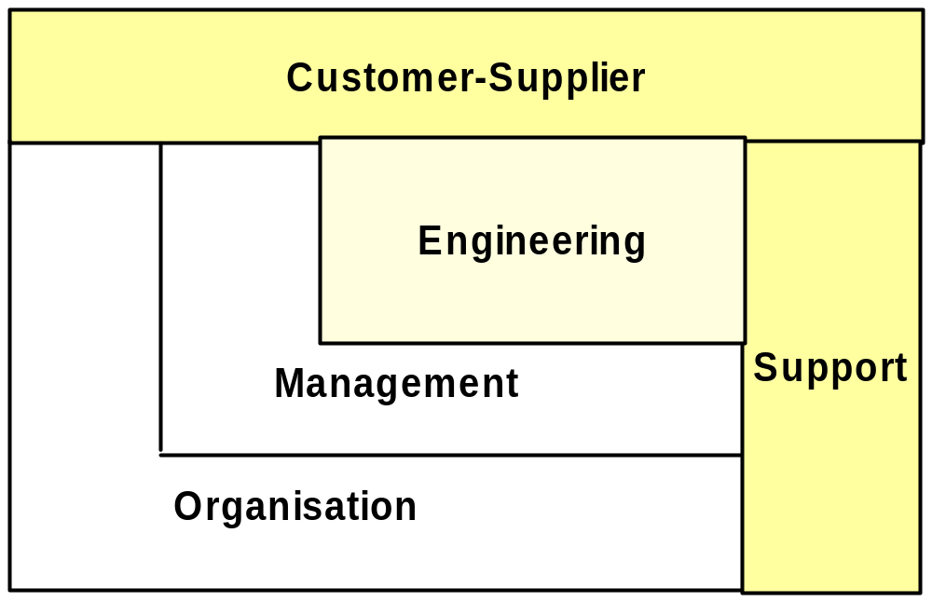
ISO 15504 / SPICE: Visual
SPICE process categories

Slide 26
ISO 15504 / SPICE: Process Categories
Processes are identified and categorised
Process categories & number of them
      5 x Customer – Supplier
      7 x Engineering Processes
      8 x Support Processes
      5 x Organisation Processes
      4 x Management Processes
To aid assessment, base practices are defined for each process category

Slide 27
ISO 15504 / SPICE: Example Process Cat.
ENG.3 – Develop Software Design
Purpose: To define a design for the software that accommodates the requirements and can be tested against them
Expected outcome: Successful implementation of the process should lead to the following:
    Developing an architectural design that describes major software components that accommodate the software requirements
    Defining internal and external interfaces of each component
    Developing a detailed design that describes software units that can be built and tested
    Establishing traceability between software requirements and software designs

Slide 28
ISO 15504 / SPICE: Process Attributes
9 Process Attributes
  Process performance
  Performance management
  Work product management
  Process definition & tailoring
  Process resource
  Process measurement
  Process control
  Process change
  Continuous improvement
Process attributes are incremental; process is expected to achieve 1, or 1 & 2, or 1, 2 & 3, or 1, 2, 3 & 4 etc.
Process attributes are generic i.e. apply to every process

Slide 29
ISO 15504 / SPICE: Assessment
For process measurement, each process attribute is measured on a four point scale:
    Not Achieved
    Partially Achieved
    Largely Achieved
    Fully Achieved
i.e. concentrates on “what”, not “how”
Because process attributes are incremental, we expect that if (say) process attribute #4 (Process Definition & Tailoring) is Fully Achieved, so too will process attributes 1, 2 & 3 etc.
Conversely, if process attribute #4 is Not Achieved, neither would process attributes 5, 6, 7, 8 & 9

Slide 30
ISO 15504 / SPICE: Capability Levels
The process attribute ratings can be used to determine the overall process capability
6 Capability levels
    Level 0 – Incomplete
    Level 1 – Performed
    Level 2 – Managed
    Level 3 – Established
    Level 4 – Predictable
    Level 5 – Optimising
This is determined by assessing the process attributes according to the following table …

Slide 31
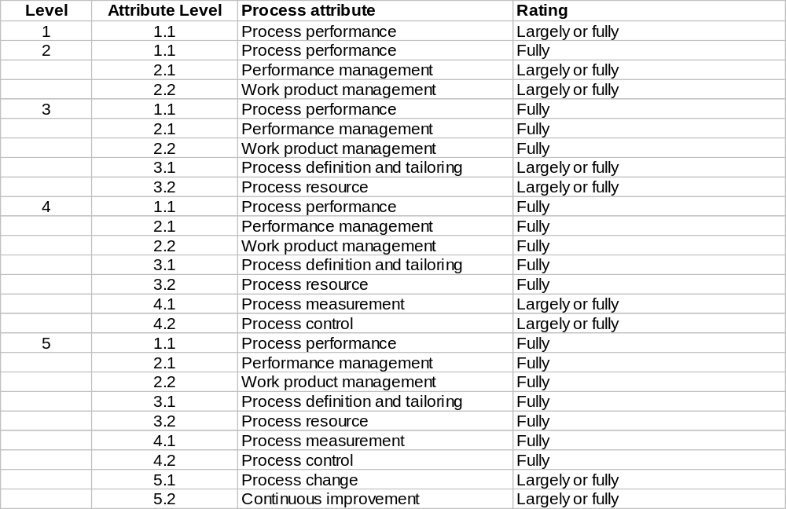
ISO 15504 / SPICE: Capability Determination

Slide 32
ISO 15504 / SPICE: Aggregation
But it gets more complicated, for two reasons:
Each process is usually measured under more than one process category e.g. Requirements Management is under
  CUS2 Manage customer needs
  ENG1 Develop system requirements
  ENG2 Develop software requirements
We can’t measure every instance of every process, so chose:
  All processes on one project
  One process on all projects
  Some processes on some projects etc.
So measurements are usually aggregated in some way

Slide 33
ISO 15504 / SPICE: Recap
Basic concept is the Process
Processes are grouped into 5 Categories
Every process is measured under 9 incremental Process Attributes
Each process measurement is assessed on a 4-point scale: Not / Partially / Largely / Fully
A process attribute rating can be expressed as a overall level of Process Capability
Aggregation is commonly used

Slide 34
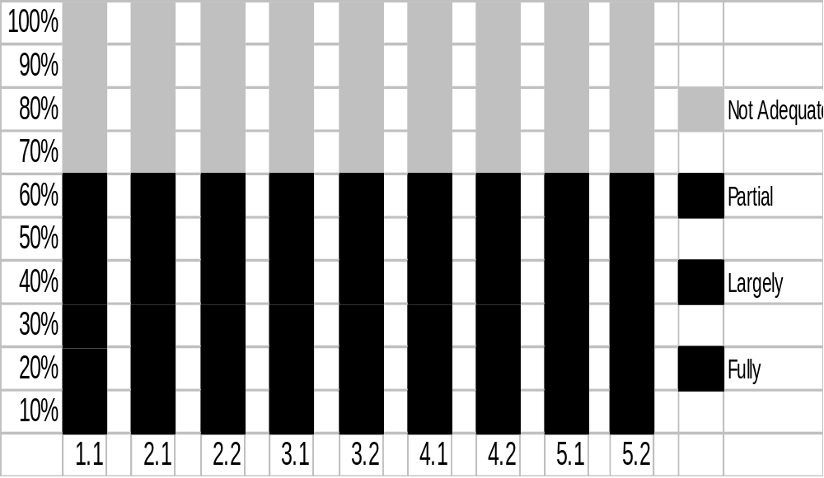
SPICE / ISO 15504: Sample
Sample SPICE assessment: for one process, for each attribute

Slide 35
SPICE / ISO 15504: Application
SPICE assessment: what does it tell us?
Done for a single process (e.g. ENG3)
Each measurement made against the 9 process attributes
Aggregated over multiple measurements, in this case probably 5 or a multiple of 5 measurements
e.g. for process attribute 2.1 (perf. mgmt): 20% fully, 40% largely & 40% partially i.e. 1 fully, 2 largely & 2 partially, none “not”
Arrive at a view of the capability of the process
What do we do with the assessment? Compare it to a target

Slide 36
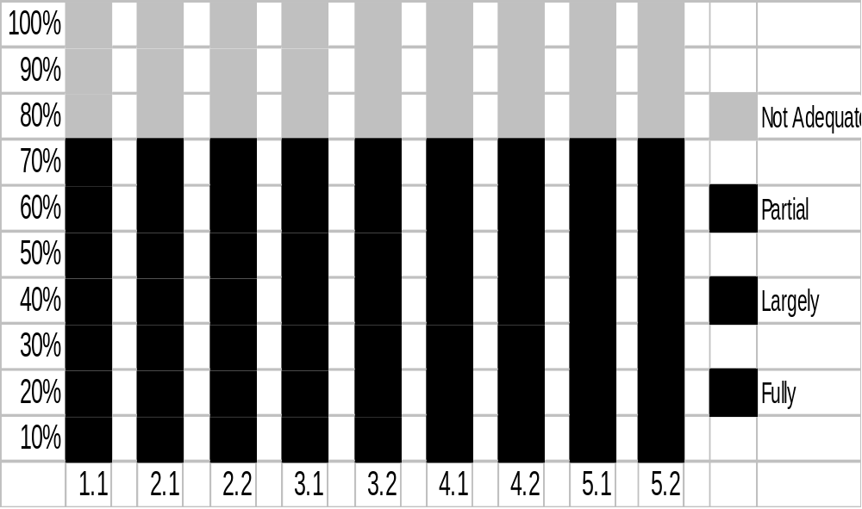
SPICE / ISO 15504: Sample Target - for one process

Slide 37
SPICE / ISO 15504: Assessment (lower) & Target (upper)
Identification of “gaps”
Target has a steady progression of capability over process attributes
Assessment is more uneven
Suggests both areas that should be improved and areas from which some resource could be drawn
Actions should:
    Be as simple as possible
    Identify risks before action
    Makes smallest changes with maximum business value first
    Be consistent with available resource

Slide 38
SPICE / ISO 15504 : Summary
  An assessment model, that can be used to guide improvement
  Universality of applicability & worldwide acceptance
  A continuous (finely graded) model
  Selective: Only processes of particular interest need be assessed
  Does not offer certification
  Relatively simple 4 scale grading allows for self-assessment

Slide 39
Next Week
Software Testing
Notes:
CS5707 Software Development Paradigms
John Dawson
CS5707 Software Development Paradigms
John Dawson
CS5707 Software Development Paradigms
John Dawson

Slide 40
Reading
Assessable paper: due week 5
Karlheinz Kautz & Peter Axel Nielsen (2004), Understanding the implementation of software process innovations in software organisations
General reading
Zahran, Chapters 13 & 15 (recommended text)
Notes:
CS5707 Software Development Paradigms
John Dawson
CS5707 Software Development Paradigms
John Dawson
CS5707 Software Development Paradigms
John Dawson

